Slide 1
Principles of Plant Systematics
J&C pp. 13-26
The Phylogenetic Approach emphasizes evolutionary relationships between groups.
Uses morphological, genetic, and chemical characters to construct a phylogenetic tree, also called a “cladogram.”
What about other approaches– Cronquist, Thorne, etc? Phylogenetic Approach builds on these previous systems.

Slide 2
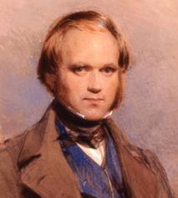
Charles Darwin (1809-1882)
Evolution→ Descent with modification.
(On the Origin of Species, 1859)
(But not the whole story! also includes separation into lineages, etc.)

Slide 3
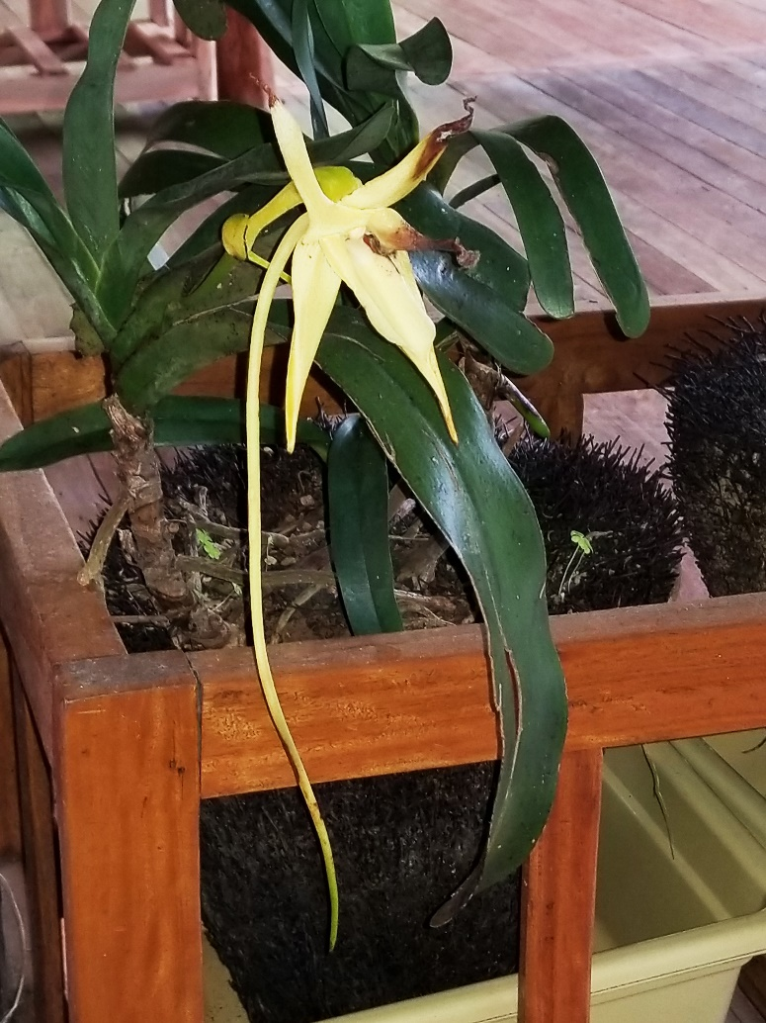
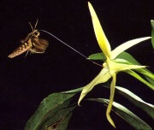
Darwin’s Orchid
A good classification system should be PREDICTIVE
Darwin's hawk moth, Xanthopan morgani praedicta, a moth with a long proboscis predicted by Darwin and found by others 20 years after his death
Angraecum sesquipedale (native to Madagascar) with long nectar spur

Slide 4
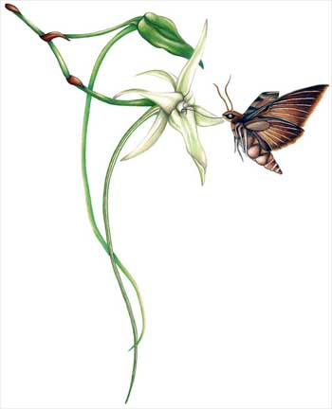
It is noteworthy for its long spur and its association with the naturalist Charles Darwin, who surmised that the flower was pollinated by a then undiscovered moth with a proboscis whose length was unprecedented at the time. His prediction had gone unverified until 21 years after his death, when the moth was discovered and his conjecture vindicated. The story of its postulated pollinator has come to be seen as one of the celebrated predictions of the theory of evolution. --by that noted philosopher, Wikipedia

Slide 5
What is a “Plant” ?
Plants all contain photosynthetic pigments chlorophyll a & b surrounded by (at least) 2 membranes.
Plants all store carbohydrates, usually in the form of starch.
Plants all have the presence of two anterior whiplash flagella at some stage of the life cycle, often modified or sometimes lost.
Footnote: all oxygenic (oxygen produced during light reactions of photosynthesis) photosynthetic organisms use chlorophyll a.

Slide 6
What is a “Plant”?
In short, any member of the Viridophyte clade!

Slide 7
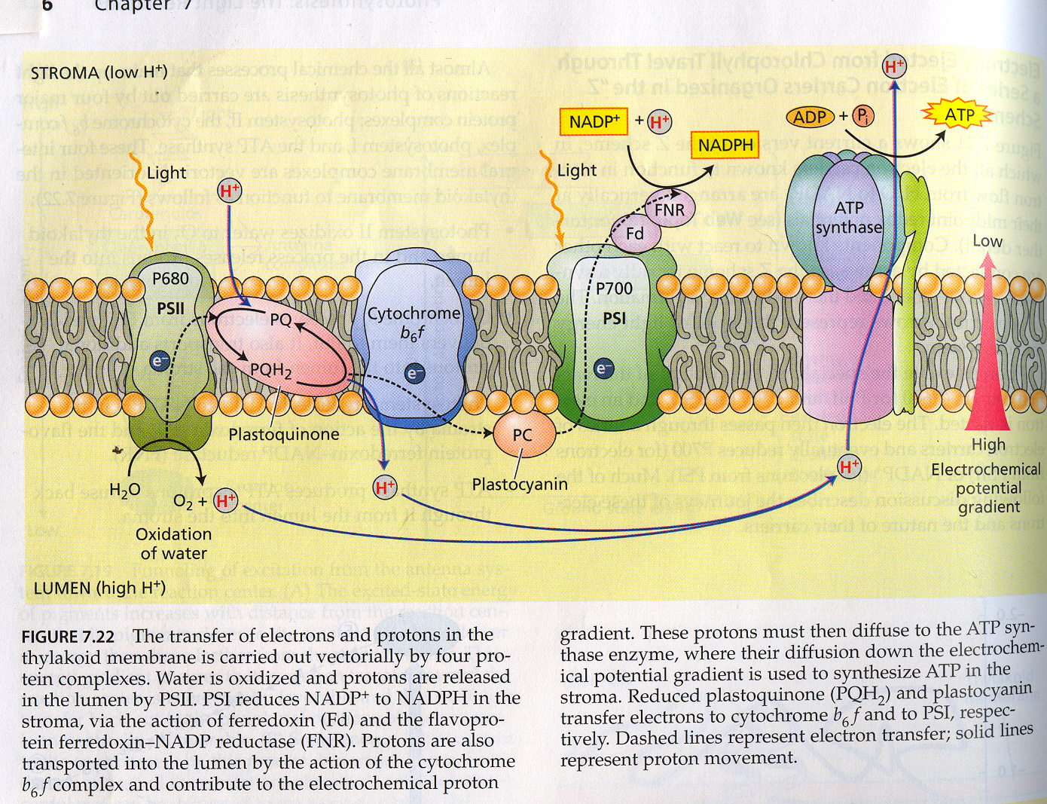

Slide 8
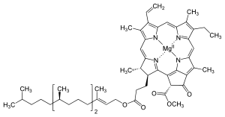
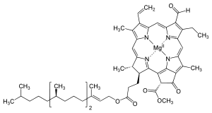
Chlorophyll a
Chlorophyll b

Slide 9
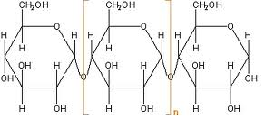
Starch
Polysaccharide composed of many glucose molecules in alpha 1-4 linkage
OK…what is cellulose?

Slide 10
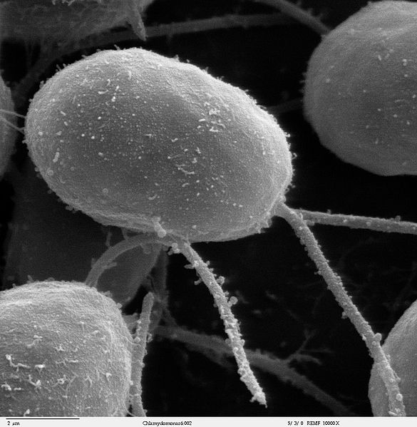
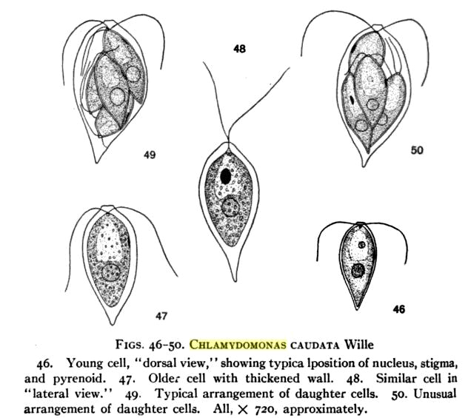
Chlamydomonas– a green alga with two anterior whiplash flagella.

Slide 11
OK…then what is “Systematics” ?
Systematics is easier to define than “plant.”
Systematics is the science of organismal diversity and the relationships between organisms.
Systematics is the study of the “biological diversity that exists on Earth today and its evolutionary history.”

Slide 12
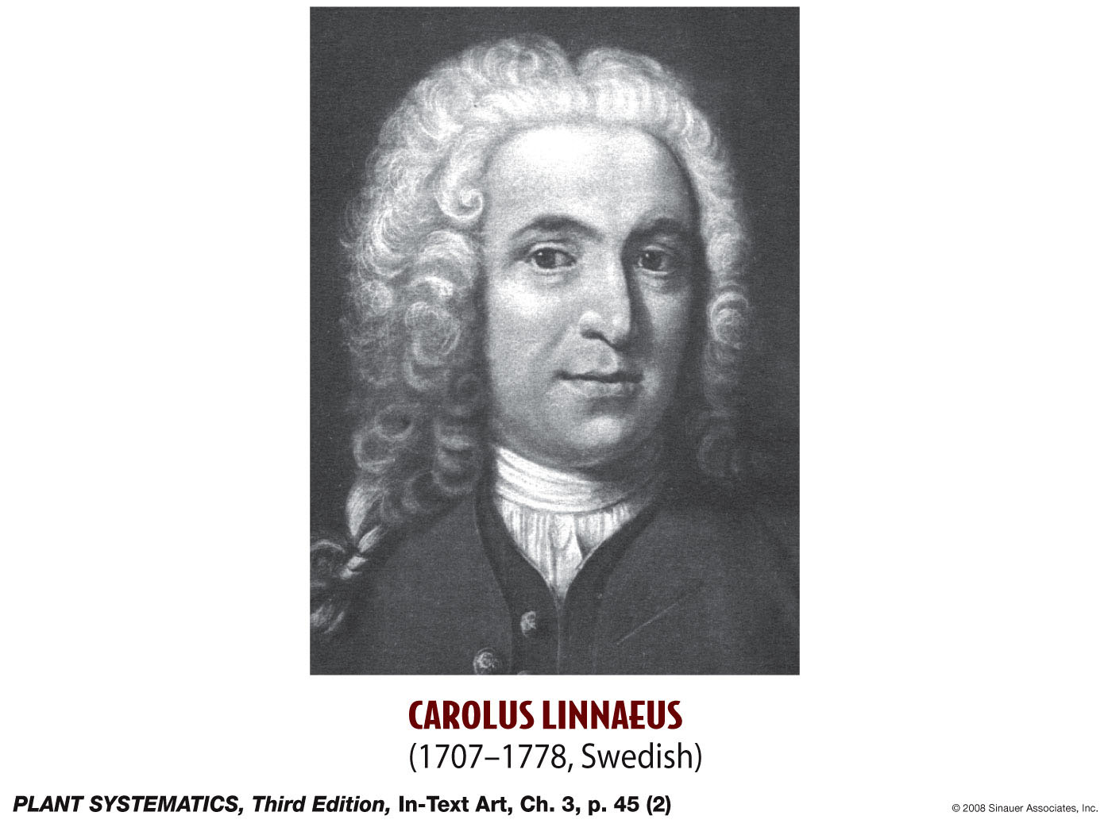
Carolus Linnaeus (before Darwin was born)

Slide 13
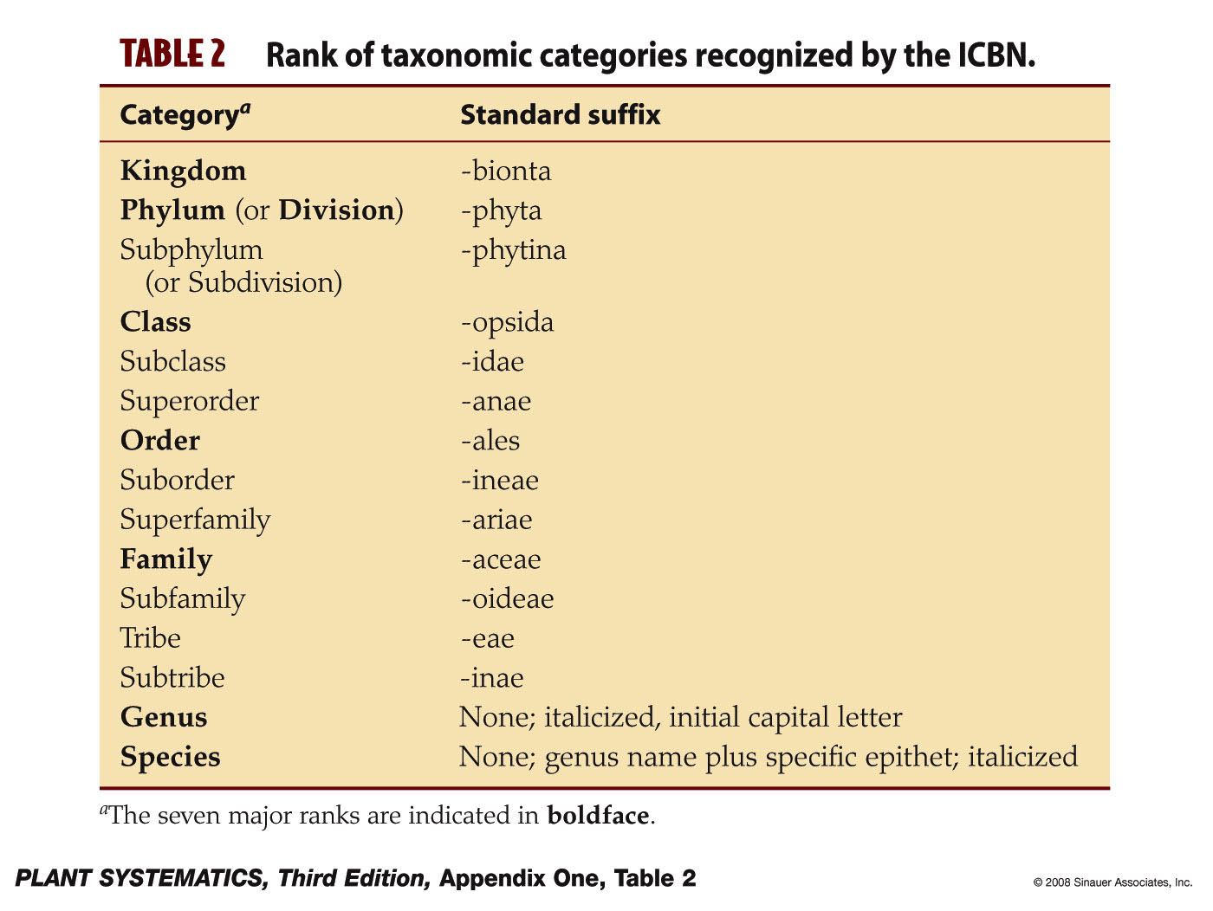
What About Linnaean Ranks?

Slide 14

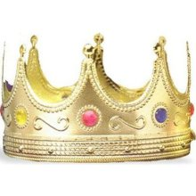
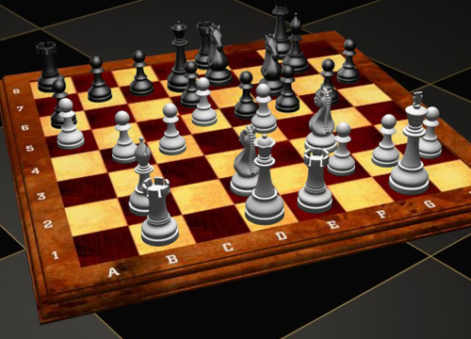

Slide 15
About Linnaean Ranks
Plants initially grouped mostly by morphology.
Basket groups were made up of plants that didn’t morphologically seem to fit anywhere else.
Did not at least initially include genetic data which hadn’t been discovered yet.
Linnaean ranks of same level are not of same evolutionary age.
We will use Linnaean ranks when they reflect evolutionary history, but discard them when they do not.

Slide 16
The Phylogenetic Approach is based on Monophyly
A monophyletic group is a “group composed of an ancestor and all of its descendants”
Synonyms: monophyletic group= Clade.
A monophyletic group can be removed from the evolutionary tree with a single cut.
Closest relatives on the evolutionary tree (also called “cladogram”) are called Sister Groups.

Slide 17
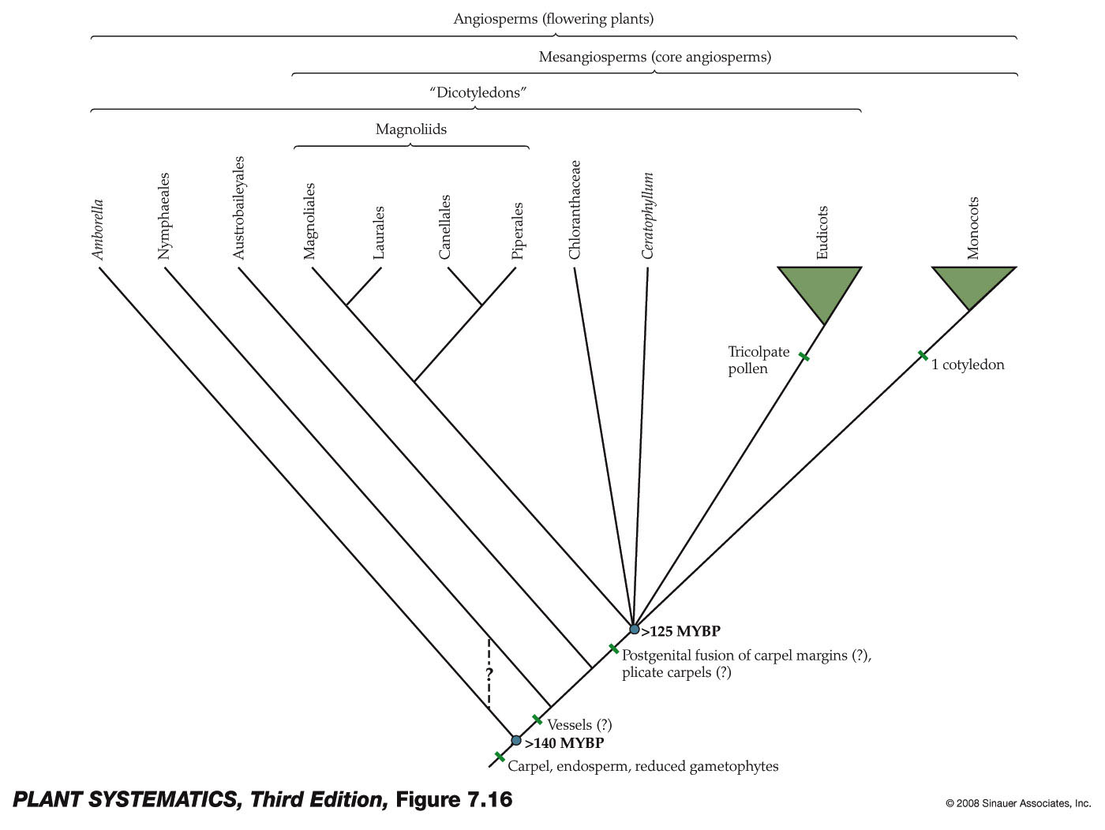
What Does a Cladogram Look Like?

Slide 18
What Does a Cladogram Look Like?
“Dicots” – a Clade?

Slide 19
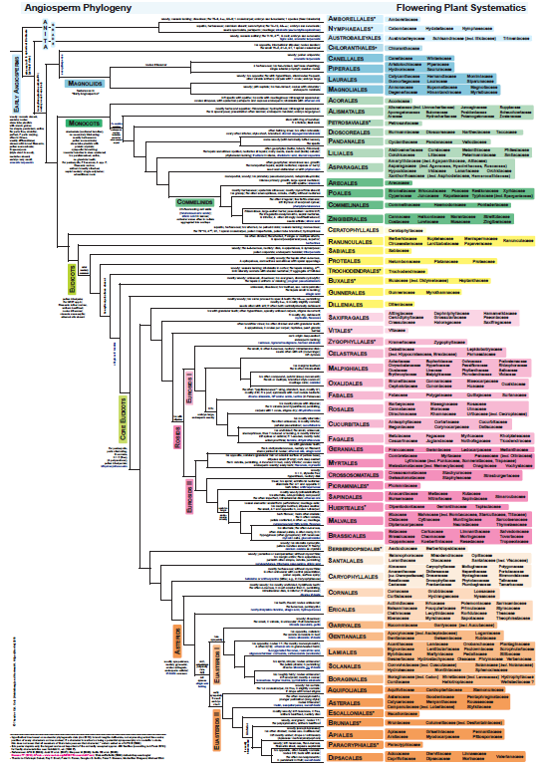

Slide 20
How Is a Cladogram Interpreted?
It is not a graph, in the sense that the axes are not labeled.
It shows relationships.
An evolutionary tree must be rooted to know which changes are relatively recent and which occurred further in the past. Piece of string analogy.
Rooting is done using an outgroup.
An outgroup is a relative of the groups under study. The outgroup separated from the ingroup lineage before the ingroup diversified.

Slide 21
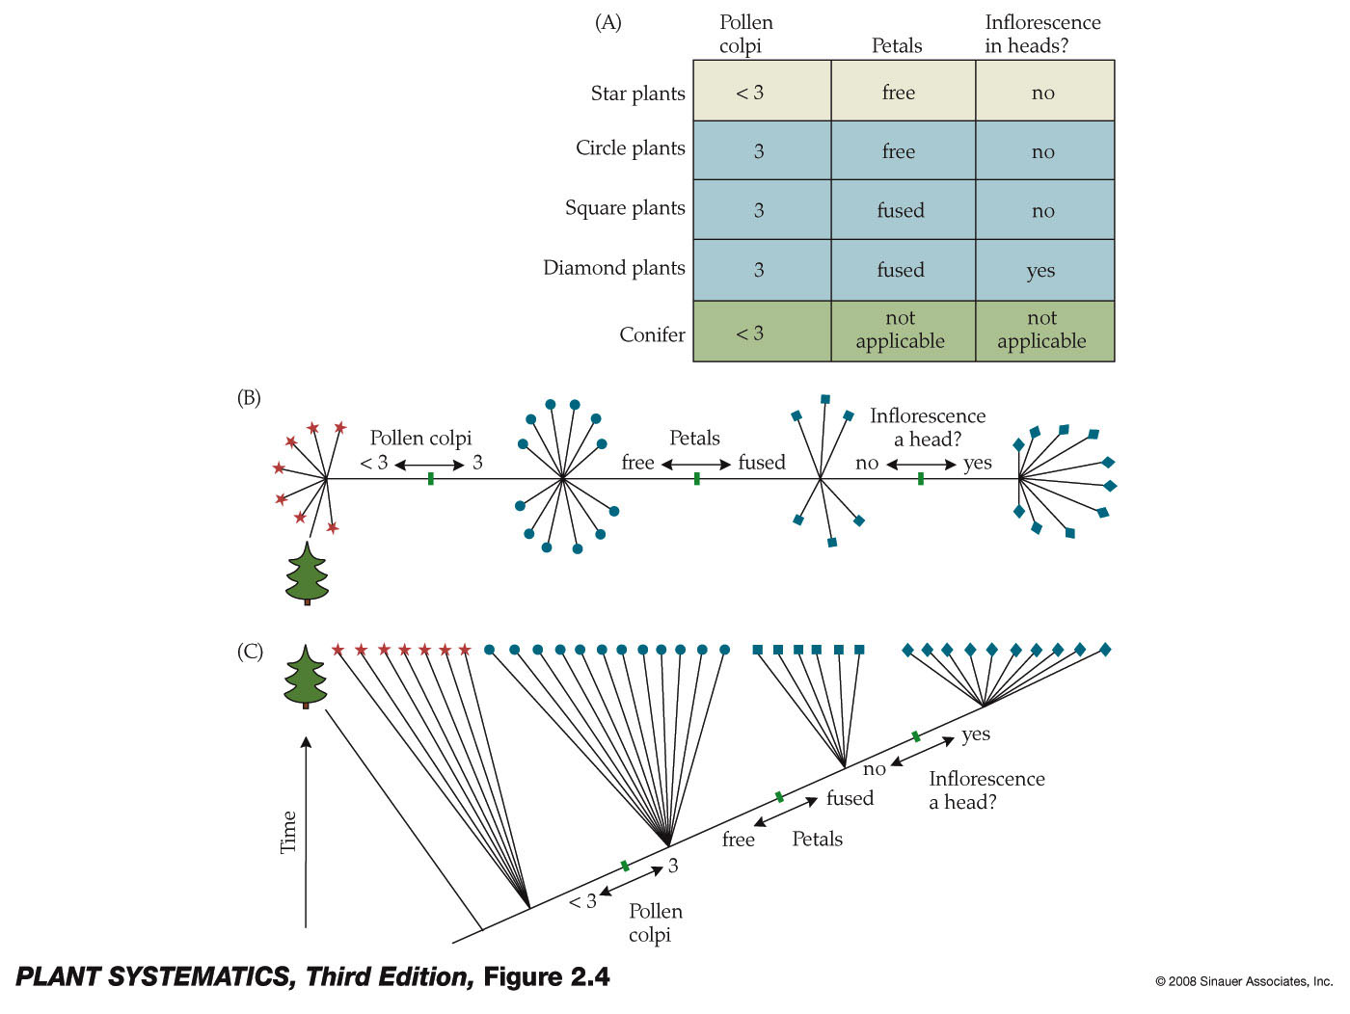
Outgroup Separated before the Ingroup Diversified

Slide 22
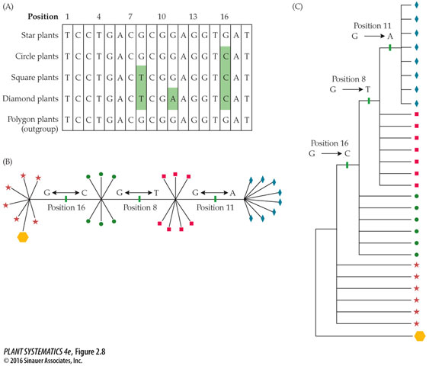

Slide 23
Determining Evolutionary History
There is uncertainty whenever more than two lineages diverge from a single point.
Groups that include a common ancestor but only some and not all of its descendents are called paraphyletic. Separate lineages diverging from different ancestors without a true common ancestor are called polyphyletic.

Slide 24
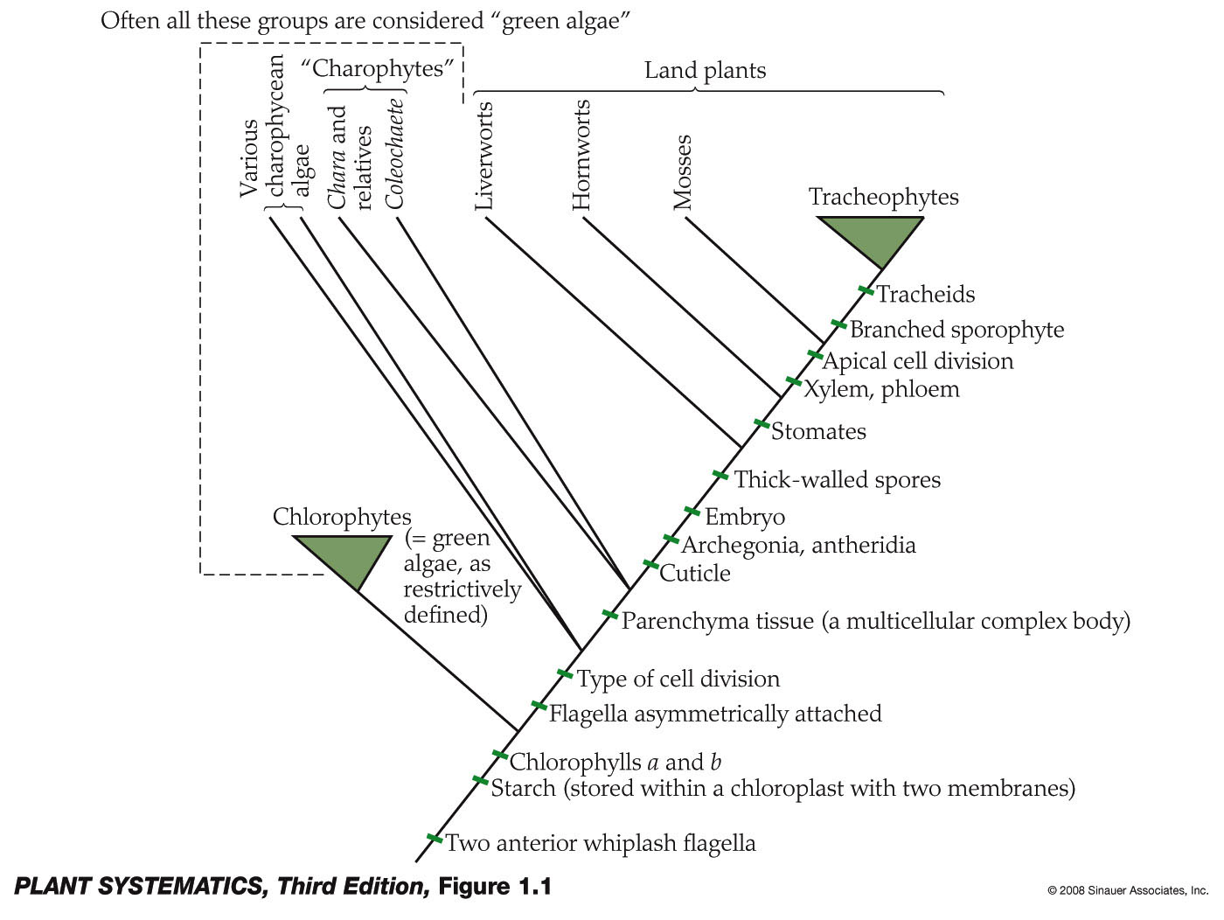
How Is a Cladogram Interpreted?

Slide 25
What is a Synapomorphy?
A synapomorphy is a shared derived character state. Synapomorphies can be used to define species and evolutionary events in a cladogram. Shown as “tic” marks on cladograms.
A symplesiomorphy is a shared ancestral character state. Symplesiomorphies are not helpful in defining current taxa. Synapomorphies may be become symplesiomorphic over evolutionary time.

Slide 26
Strength of Evidence for a Clade
Evidence is strongest for those groups that have the most synapomorphies, morphological, chemical, genetic, etc. (any kind of synapomorphy.)
The more “tic” marks leading to a monophyletic group (clade) the stronger the evidence for it.

Slide 27
How Is a Cladogram Interpreted?

Slide 28
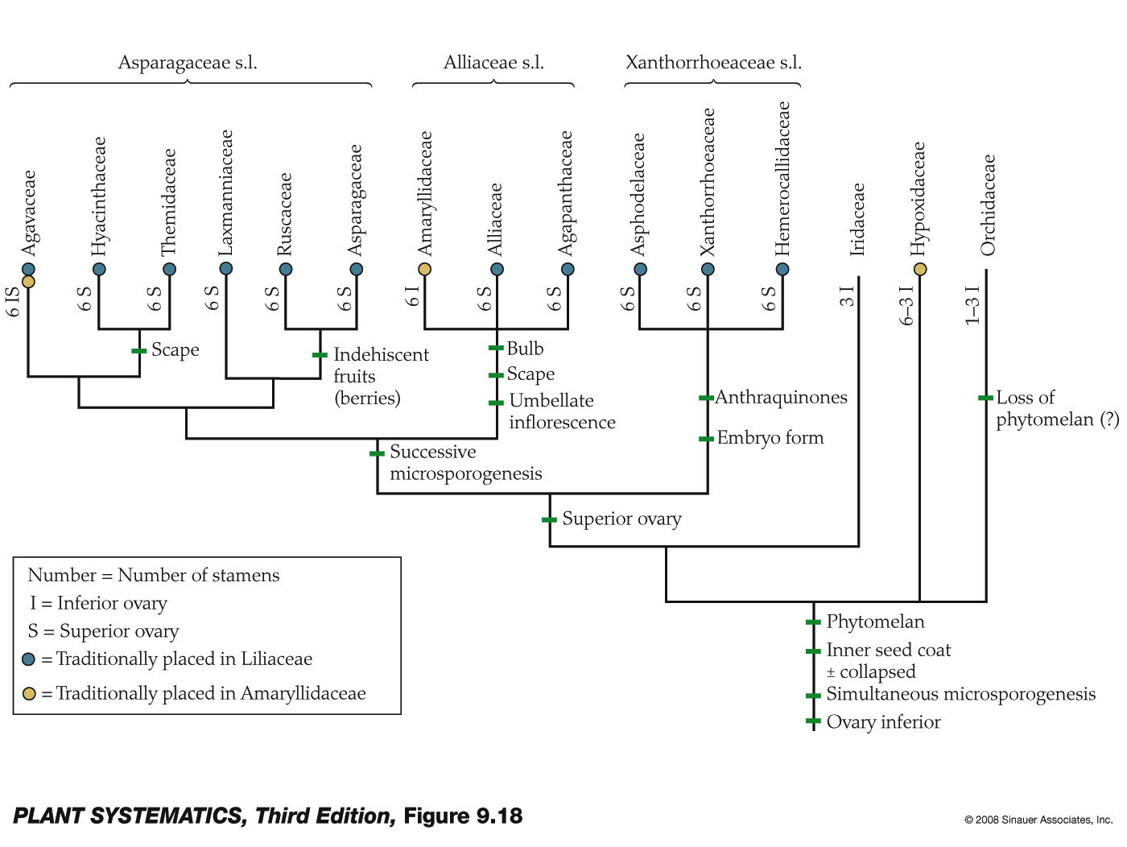
Asparagales

Slide 29
Homology
Identity by descent
A character is homologous if the species in question all inherited the trait from a common ancestor.
A seal’s front fins are homologous to our arms.
Our arms are not homologous to those of a spider.

Slide 30
Homoplasy
Similarity without identity by descent.
Can be caused by parallelism (i.e., “convergent evolution”) in two unrelated lineages.
Can be caused by a reversal of a character state within a lineage.
Homoplasies make it much harder to determine evolutionary history (i.e., to construct an accurate cladogram.)

Slide 31
Should You Believe the Tree?
Parsimony/Occam’s Razor
Many different statistical methods to make and test trees, most done on computers these days:
Bootstrap analysis– sampling the original alignment with replacement
Bayesian methods– includes “posterior probability”, knowledge accrued before the data analysis in question

